Slide 1
Chapter 4 : Intermediate SQL

Slide 2
Outline
Join Expressions
Views
Transactions
Integrity Constraints
SQL Data Types and Schemas
Index Definition in SQL
Authorization
Notes:
1

Slide 3
Joined Relations
Join operations take two relations and return as a result another relation.
A join operation is a Cartesian product which requires that tuples in the two relations match (under some condition). It also specifies the attributes that are present in the result of the join
The join operations are typically used as subquery expressions in the from clause
Three types of joins:
  Natural join
  Inner join
  Outer join

Slide 4
Schema of University Database
classroom(building, room number, capacity)
department(dept name, building, budget)
course(course id, title, dept name, credits)
instructor(ID, name, dept name, salary)
section(course id, sec id, semester, year, building, room number, time slot id)
teaches(ID, course id, sec id, semester, year)
student(ID, name, dept name, tot cred)
takes(ID, course id, sec id, semester, year, grade)
advisor(s ID, i ID)
time slot(time slot id, day, start time, end time)
Prereq (course id, prereq id)

Slide 5
Natural Join in SQL
Natural join matches tuples with the same values for all common attributes, and retains only one copy of each common column.
List the names of students along with the course ID of the courses that they take
  select name, course_id
  from students, takes
  where student.ID = takes.ID;
Same query in SQL with “natural join” construct
  select name, course_id
  from student natural join takes;
student(ID, name, dept name, tot cred)
takes(ID, course id, sec id, semester, year, grade)

Slide 6
Natural Join in SQL
The from clause can have multiple relations combined using natural join:
  select A₁, A₂, … A_{n}
  from r₁ natural join r₂ natural join .. natural join r_{n}
  where P ;

Slide 7
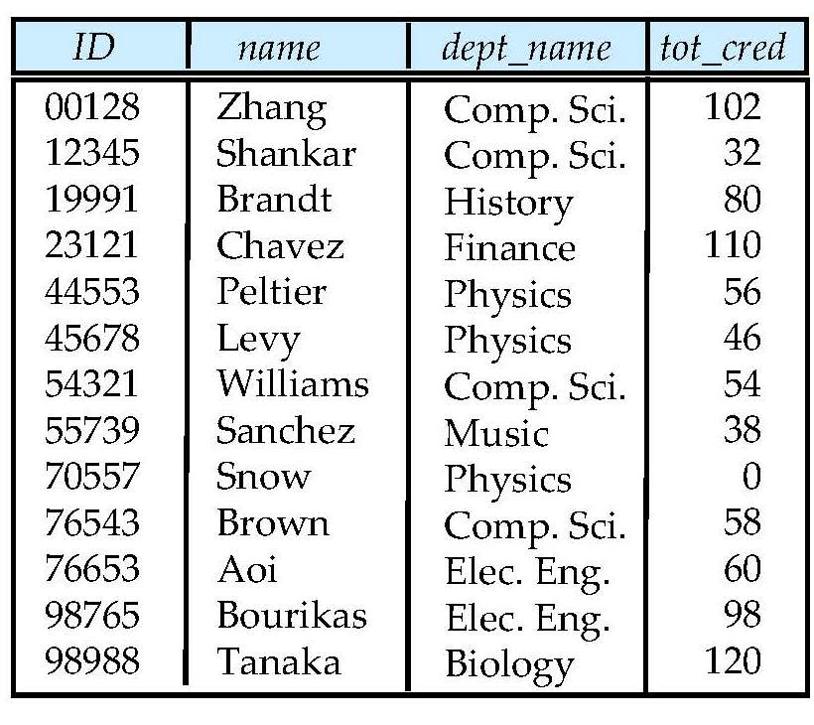
Student Relation

Slide 8
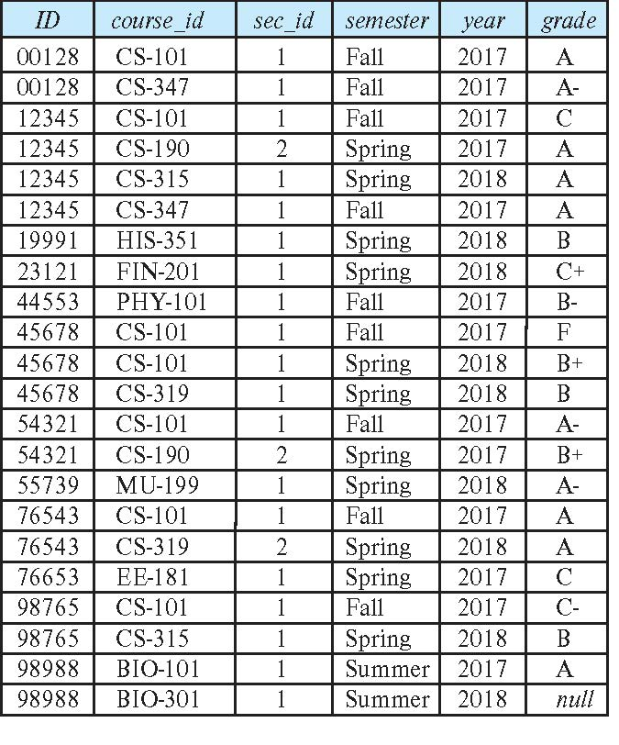
Takes Relation

Slide 9
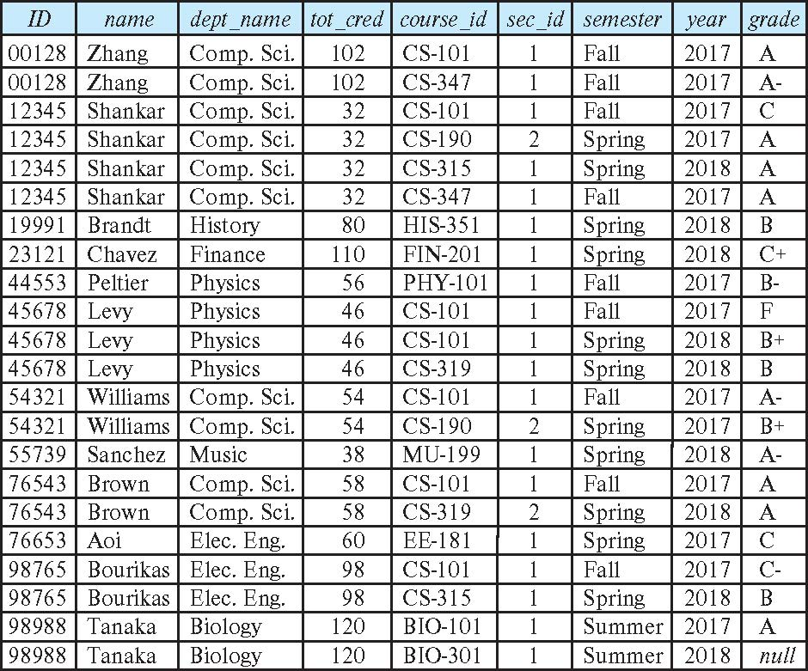
student natural join takes

Slide 10
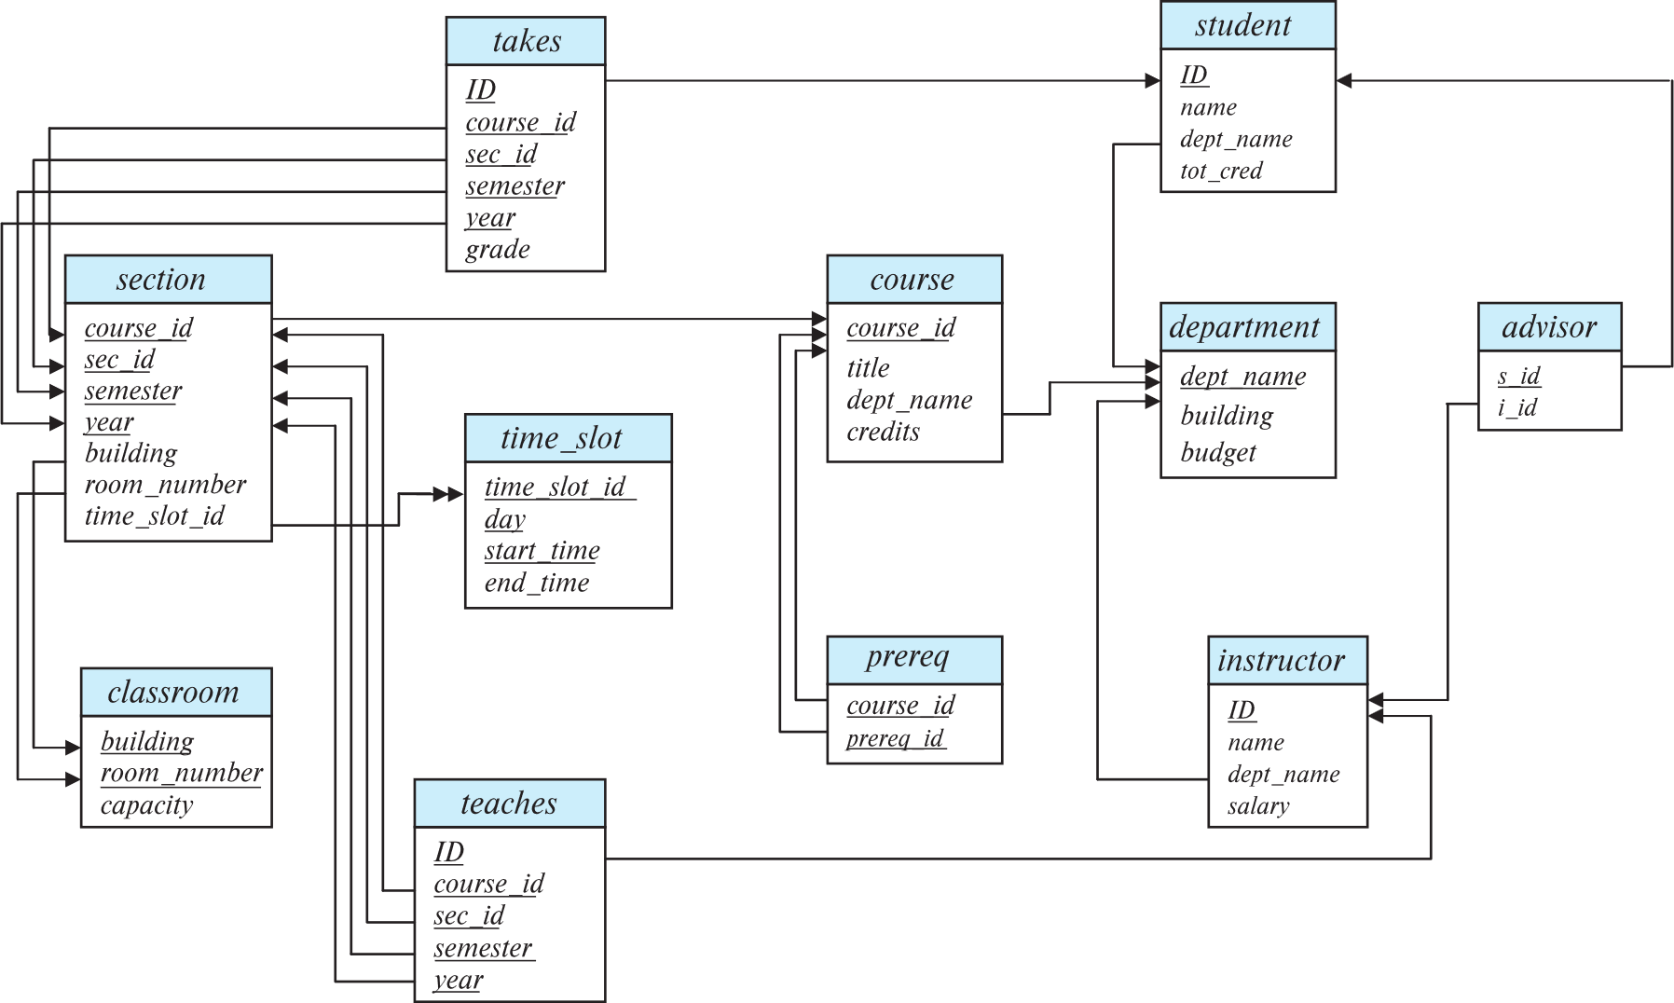
Schema Diagram for University Database

Slide 11
Schema of University Database
classroom(building, room number, capacity)
department(dept name, building, budget)
course(course id, title, dept name, credits)
instructor(ID, name, dept name, salary)
section(course id, sec id, semester, year, building, room number, time slot id)
teaches(ID, course id, sec id, semester, year)
student(ID, name, dept name, tot cred)
takes(ID, course id, sec id, semester, year, grade)
advisor(s ID, i ID)
time slot(time slot id, day, start time, end time)
Prereq (course id, prereq id)

Slide 12
Natural Join
Beware of unrelated attributes with same name which get equated incorrectly
Example -- List the names of students along with the titles of courses that they have taken
  Correct version
  select name, title
  from student natural join takes, course
  where takes.course_id = course.course_id;
  Incorrect version
    select name, title
    from student natural join takes natural join course;
    This query omits all (student name, course title) pairs where the student takes a course in a department other than the student's own department.
Course (course id, title, dept name, credits)
Student (ID, name, dept name, tot cred)
Takes (ID, course id, sec id, semester, year, grade)

Slide 13
Natural Join with Using Clause
To avoid the danger of equating attributes erroneously, we can use the “using” construct that allows us to specify exactly which columns should be equated.
Query example
select name, title
from (student natural join takes) join course using (course_id)
  CS department student may take a Math department course
  Joining only over Course_id while omitting join over the other common attribute ‘dept_name’

Slide 14
Join Condition
The on condition allows a general predicate over the relations being joined
This predicate is written like a where clause predicate except for the use of the keyword on
Query example
select *
from student join takes on student.ID = takes.ID
  The on condition above specifies that a tuple from student matches a tuple from takes if their ID values are equal.
Equivalent to:
select *
from student , takes
where student_ID = takes_ID

Slide 15
Outer Join
An extension of the join operation that avoids loss of information.
Computes the join and then adds tuples form one relation that does not match tuples in the other relation to the result of the join.
Uses null values.
Three forms of outer join:
  left outer join
  right outer join
  full outer join

Slide 16


Outer Join Examples
Relation course
Relation prereq
Observe that
course information is missing CS-437
prereq information is missing CS-315

Slide 17
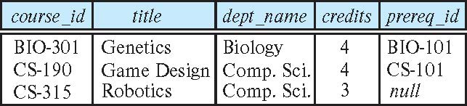
Left Outer Join ⟕
course natural left outer join prereq
  In relational algebra: course ⟕ prereq

Slide 18
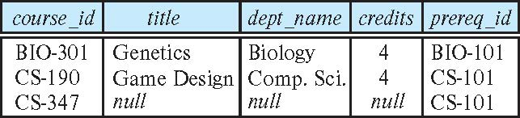
Right Outer Join ⟖
course natural right outer join prereq
  In relational algebra: course ⟖ prereq

Slide 19
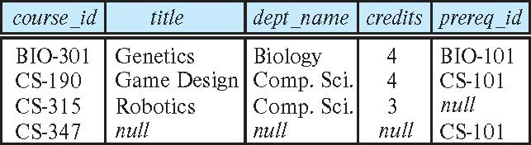
Full Outer Join ⟗
course natural full outer join prereq
In relational algebra: course ⟗ prereq

Slide 20
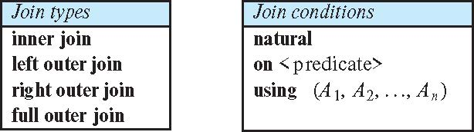
Joined Types and Conditions
Join operations take two relations and return as a result another relation.
These additional operations are typically used as subquery expressions in the from clause
Join condition – defines which tuples in the two relations match.
Join type – defines how tuples in each relation that do not match any tuple in the other relation (based on the join condition) are treated.

Slide 21
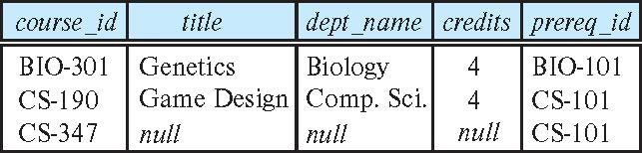
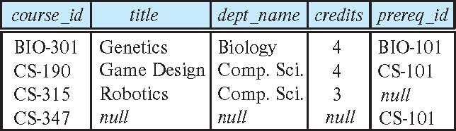
Joined Relations – Examples
course natural right outer join prereq
course full outer join prereq using (course_id)

Slide 22
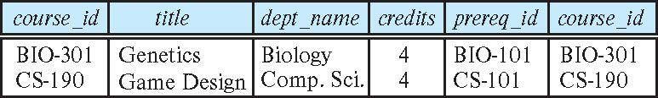
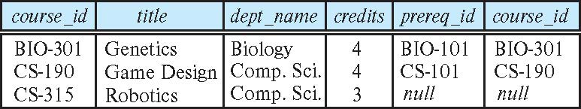
Joined Relations – Examples
course inner join prereq on
course.course_id = prereq.course_id
What is the difference between the above, and a natural join?
course left outer join prereq on
course.course_id = prereq.course_id

Slide 23
Joined Relations – Examples
course natural right outer join prereq
course natural full outer join prereq using (course_id)

Slide 24
Views
In some cases, it is not desirable for all users to see the entire logical model (that is, all the actual relations stored in the database.)
Consider a person who needs to know an instructors name and department, but not the salary. This person should see a relation described, in SQL, by
select ID, name, dept_name
from instructor
A view provides a mechanism to hide certain data from the view of certain users.
Any relation that is not of the conceptual model but is made visible to a user as a “virtual relation” is called a view.

Slide 25
View Definition
A view is defined using the create view statement which has the form
create view v as < query expression >
where <query expression> is any legal SQL expression. The view name is represented by v.
Once a view is defined, the view name can be used to refer to the virtual relation that the view generates.
View definition is not the same as creating a new relation by evaluating the query expression
  Rather, a view definition causes the saving of an expression; the expression is substituted into queries using the view.

Slide 26
View Definition and Use
A view of instructors without their salary
create view faculty as
select ID, name, dept_name
from instructor
Find all instructors in the Biology department
select name
from faculty
where dept_name = 'Biology'
Create a view of department salary totals
create view departments_total_salary(dept_name, total_salary) as
select dept_name, sum (salary)
from instructor
group by dept_name;

Slide 27
Views Defined Using Other Views
One view may be used in the expression defining another view
A view relation v₁ is said to depend directly on a view relation v₂ if v₂ is used in the expression defining v₁
A view relation v₁ is said to depend on view relation v₂ if either v₁ depends directly to v₂ or there is a path of dependencies from v₁ to v₂
A view relation v is said to be recursive if it depends on itself.

Slide 28
Views Defined Using Other Views
create view physics_fall_2017 as
select course.course_id, sec_id, building, room_number
from course, section
where course.course_id = section.course_id
and course.dept_name = 'Physics'
and section.semester = 'Fall'
and section.year = '2017’;
create view physics_fall_2017_watson as
select course_id, room_number
from physics_fall_2017
where building= 'Watson';

Slide 29
View Expansion
Expand the view :
create view physics_fall_2017_watson as
select course_id, room_number
from physics_fall_2017
where building= 'Watson'
To:
create view physics_fall_2017_watson as
select course_id, room_number
from (select course.course_id, building, room_number
from course, section
where course.course_id = section.course_id
and course.dept_name = 'Physics'
and section.semester = 'Fall'
and section.year = '2017')
where building= 'Watson';

Slide 30
View Expansion
A way to define the meaning of views defined in terms of other views.
Let view v₁ be defined by an expression e₁ that may itself contain uses of view relations.
View expansion of an expression repeats the following replacement step:
repeat
Find any view relation v_{i} in e₁
Replace the view relation v_{i} by the expression defining v_{i}
until no more view relations are present in e₁
As long as the view definitions are not recursive, this loop will terminate

Slide 31
Materialized Views
Certain database systems allow view relations to be physically stored.
  Physical copy created when the view is defined.
  Such views are called Materialized view:
If relations used in the query are updated, the materialized view result becomes out of date
  Need to maintain the view, by updating the view whenever the underlying relations are updated.
  Storage
  Stale results/ refresh / maintenance
  Periodically or only when the view is accessed

Slide 32
Update to a relation/database through a View
Add a new tuple to faculty view which we defined earlier
insert into faculty
values ('30765', 'Green', 'Music');
This insertion must be represented by the insertion into the instructor relation
  Must have a value for salary.
Two approaches
  Reject the insert
  Insert the tuple
('30765', 'Green', 'Music', null)
into the instructor relation

Slide 33
Some Updates Cannot be Translated Uniquely
create view instructor_info as
select ID, name, building
from instructor, department
where instructor.dept_name= department.dept_name;
insert into instructor_info
values ('69987', 'White', 'Taylor');
  Which department, if multiple/ or no departments in Taylor?
  What if no department is in Taylor?
  Insert (‘69987’, ‘White’, null,null) into Instructor
  Insert (null, ‘Taylor’, null) into Department
  These updates do not have the desired effect on instructor_info as it still doesnot have a tuple (69987, White, Taylor)
  There is no way to update Instructor and Department by using a null values in instructor and department to get desired update on instructor_info
  Different database systems specify different conditions under which updations through views are permitted.

Slide 34
And Some Not at All
create view history_instructors as
select *
from instructor
where dept_name= 'History';
What happens if we try to insert
('25566', 'Brown', 'Biology', 100000)
into history_instructors?
It will get inserted into Instructor but not visible in the history_instructors

Slide 35
View Updates in SQL
Most SQL implementations allow updates only on simple views
  The from clause has only one database relation.
  The select clause contains only attribute names of the relation, and does not have any expressions, aggregates, or distinct specification.
Any attribute not listed in the select clause can be set to null; that is, it does not have a not null constraint and is not part of a primary key
The query does not have a group by or having clause.

Slide 36
Transaction
A transaction is a unit of program execution that accesses and possibly updates various data items.
E.g., transaction to transfer $50 from account A to account B:
  1. read(A)
  2. A := A – 50
  3. write(A)
  4. read(B)
  5. B := B + 50
  6. write(B)
Two main issues to deal with:
  Failures of various kinds, such as hardware failures and system crashes
  Concurrent execution of multiple transactions
  ACID Properties

Slide 37
Transactions
A transaction consists of a sequence of query and/or update statements and is a “unit” of work
The SQL standard specifies that a transaction begins implicitly when an SQL statement is executed.
The transaction must end with one of the following statements:
  Commit work. The updates performed by the transaction become permanent in the database.
  Rollback work. All the updates performed by the SQL statements in the transaction are undone.
Atomic transaction
  either fully executed or rolled back as if it never occurred
Isolation from concurrent transactions

Slide 38
Transfer of money
Transaction to transfer $50 from account A to account B:
  1. read(A)
  2. A := A – 50
  3. write(A)
  4. read(B)
  5. B := B + 50
  6. write(B)
Atomicity requirement
  If the transaction fails after step 3 and before step 6, money will be “lost” leading to an inconsistent database state
    Failure could be due to software or hardware
  The system should ensure that updates of a partially executed transaction are not reflected in the database
Durability requirement — once the user has been notified that the transaction has completed (i.e., the transfer of the $50 has taken place), the updates to the database by the transaction must persist even if there are software or hardware failures.

Slide 39
Transfer of money
Consistency requirement in above example:
  The sum of A and B is unchanged by the execution of the transaction
In general, consistency requirements include
  Explicitly specified integrity constraints such as primary keys and foreign keys
  Implicit integrity constraints
    e.g., sum of balances of all accounts, minus sum of loan amounts must equal value of cash-in-hand
  A transaction must see a consistent database.
  During transaction execution the database may be temporarily inconsistent.
  When the transaction completes successfully the database must be consistent
    Erroneous transaction logic can lead to inconsistency

Slide 40
Transfer of money
Isolation requirement — if between steps 3 and 6, another transaction T2 is allowed to access the partially updated database, it will see an inconsistent database (the sum A + B will be less than it should be).
T1 T2
  1. read(A)
  2. A := A – 50
  3. write(A)
  read(A), read(B), print(A+B)
  4. read(B)
  5. B := B + 50
  6. write(B
Isolation can be ensured trivially by running transactions serially
  That is, one after the other.
However, executing multiple transactions concurrently has significant benefits, as we will see later.

Slide 41
Integrity
Assurance that data always remains as intended
Storage, retrieval, processing
Integrity Constraints
  Entity Integrity
  Referential Integrity
  Domain Integrity
  User Defined Integrity

Slide 42
Integrity Constraints
Integrity constraints guard against accidental damage to the database, by ensuring that authorized changes to the database do not result in a loss of data consistency.
  A checking account must have a balance greater than $10,000.00
  A salary of a bank employee must be at least $4.00 an hour
  A customer must have a (non-null) phone number

Slide 43
Integrity Constraints
Create table
Alter table tablename add constraint
Constraint is added to the relation only if it satisfies the constraint (at the time of executing this alter table command)

Slide 44
Constraints on a Single Relation
not null
primary key
unique
check (P), where P is a predicate

Slide 45
Not Null Constraints
not null
  Declare name and budget to be not null
name varchar(20) not null
budget numeric(12,2) not null

Slide 46
Unique Constraints
unique ( A₁, A₂, …, A_{m})
  The unique specification states that the attributes A₁, A₂, …, A_{m} form a candidate key or a superkey
  No two tuples in the relation can be equal on all the (A1,…Am)
  Attributes in unique are permitted to be null (in contrast to primary keys) unless explicitly declared to be non null

Slide 47
The check clause
The check (P) clause specifies a predicate P that must be satisfied by every tuple in a relation.
Example: ensure that semester is one of fall, winter, spring or summer
create table section
(course_id varchar (8),
sec_id varchar (8),
semester varchar (6),
year numeric (4,0),
building varchar (15),
room_number varchar (7),
time slot id varchar (4),
primary key (course_id, sec_id, semester, year),
check (semester in ('Fall', 'Winter', 'Spring', 'Summer')))
Here check allows us to make domain constraint (varchar) more restrictive

Slide 48
Check
create table department
  (dept name varchar (20),
  building varchar (15),
  budget numeric (12,2) check (budget > 0),
  primary key (dept name));
  In create table statement:
  Put simple attribute value check along with the attribute
  Complex checks can be placed at the end of the create table statement

Slide 49
Referential Integrity
Ensures that a value that appears in one relation for a given set of attributes also appears for a certain set of attributes in another relation.
  Example: If “Biology” is a department name appearing in one of the tuples in the instructor relation, then there exists a tuple in the department relation for “Biology”.
Let A be a set of attributes. Let R and S be two relations that contain attributes A and where A is the primary key of S. A is said to be a foreign key of R if for any values of A appearing in R these values also appear in S.
Instructor (ID, name, dept_name, salary)
Department ( dept_name, building, budget)

Slide 50
Referential Integrity
Foreign keys can be specified as part of the SQL create table statement
foreign key (dept_name) references department
By default, a foreign key references the primary-key attributes of the referenced table.
SQL allows a list of attributes of the referenced relation to be specified explicitly.
foreign key (dept_name) references department (dept_name)
Instructor (ID, name, dept_name, salary)
Department ( dept_name, building, budget)

Slide 51
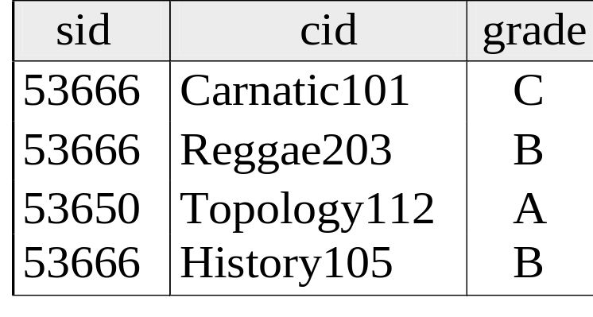
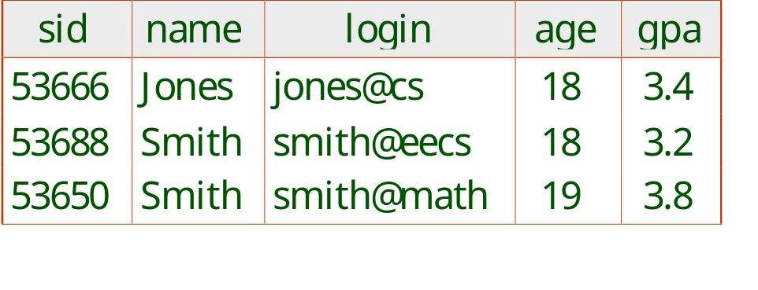
Foreign Keys in SQL
Only students listed in the Students relation should be allowed to enroll for courses
CREATE TABLE Enrolled
(sid CHAR(20), cid CHAR(20), grade CHAR(2),
PRIMARY KEY (sid,cid),
FOREIGN KEY (sid) REFERENCES Students )
Enrolled
Students
Notes:
7

Slide 52
Cascading Actions in Referential Integrity
When a referential-integrity constraint is violated, the normal procedure is to reject the action that caused the violation.
An alternative, in case of delete or update is to cascade
create table course (
(…
dept_name varchar(20),
foreign key (dept_name) references department
on delete cascade
on update cascade,
. . .)
Instead of cascade we can use :
  set null,
  set default
Course( courseID, title,dept_name, credits)
Department ( dept_name, building, budget)

Slide 53
Integrity Constraint Violation During Transactions
Consider:
  create table person (
  ID char(10),
  name char(40),
  mother char(10),
  father char(10),
  primary key ID,
  foreign key father references person,
  foreign key mother references person)
How to insert a tuple without causing constraint violation?
  Insert father and mother of a person before inserting person
  OR, set father and mother to null initially, update after inserting all persons (not possible if father and mother attributes declared to be not null)
  OR defer constraint checking

Slide 54
Complex Check Conditions
The predicate in the check clause can be an arbitrary predicate that can include a subquery.
check (time_slot_id in (select time_slot_id from time_slot))
The check condition states that the time_slot_id in each tuple in the section relation is actually the identifier of a time slot in the time_slot relation.
  The condition has to be checked not only when a tuple is inserted or modified in section , but also when the relation time_slot changes
  Section (courseID, Sec_ID, semester, year, building, room_number, timeslot_ID)
  Timeslot (timeslot_ID, day, start_time, end_time)

Slide 55
Assertions
An assertion is a predicate expressing a condition that we wish the database always to satisfy.
The following constraints, can be expressed using assertions:
For each tuple in the student relation, the value of the attribute tot_cred must equal the sum of credits of courses that the student has completed successfully.
An instructor cannot teach in two different classrooms in a semester in the same time slot
An assertion in SQL takes the form:
create assertion <assertion-name> check (<predicate>);

Slide 56
Built-in Data Types in SQL
date: Dates, containing a (4 digit) year, month and date
  Example: date '2005-7-27'
time: Time of day, in hours, minutes and seconds.
  Example: time '09:00:30' time '09:00:30.75'
timestamp: date plus time of day
  Example: timestamp '2005-7-27 09:00:30.75'
interval: period of time
  Example: interval '1' day
  Subtracting a date/time/timestamp value from another gives an interval value
  Interval values can be added to date/time/timestamp values

Slide 57
Default value
  create table student
  (ID varchar (5),
  name varchar (20) not null,
  dept name varchar (20),
  tot cred numeric (3,0) default 0,
  primary key (ID));

Slide 58
Large-Object Types
Large objects/ data items (photos, videos, CAD files, etc.) are stored as a large object:
  blob: binary large object -- object is a large collection of uninterpreted binary data (whose interpretation is left to an application outside of the database system)
  clob: character large object -- object is a large collection of character data
When a query returns a large object, a pointer is returned rather than the large object itself.
book review clob(10KB)
image blob(10MB)
movie blob(2GB)

Slide 59
User-Defined Types
create type construct in SQL creates user-defined type
  create type Dollars as numeric (12,2)
Example:
create table department
(dept_name varchar (20),
building varchar (15),
budget Dollars);

Slide 60
Domains
create domain construct in SQL-92 creates user-defined domain types
  create domain person_name char(20) not null
Types and domains are similar. Domains can have constraints, such as not null, specified on them.
Example:
create domain degree_level varchar(10)
constraint degree_level_test
check (value in ('Bachelors', 'Masters', 'Doctorate'));
create domain DDollars as numeric(12,2) not null;
Can have constraints

Slide 61
Index Creation
Many queries reference only a small proportion of the records in a table.
It is inefficient for the system to read every record to find a record with particular value
An index on an attribute of a relation is a data structure that allows the database system to find those tuples in the relation that have a specified value for that attribute efficiently, without scanning through all the tuples of the relation.
We create an index with the create index command
create index <name> on <relation-name> (attribute);

Slide 62
Index Creation Example
create index <name> on <relation-name> (attribute);
create table student
(ID varchar (5),
name varchar (20) not null,
dept_name varchar (20),
tot_cred numeric (3,0) default 0,
primary key (ID))
create index studentID_index on student(ID)
The query:
select *
from student
where ID = '12345'
can be executed by using the index to find the required record, without looking at all records of student
drop index <index-name>;

Slide 63
Authorization
We may assign a user several forms of authorizations on parts of the database.
  Read - allows reading, but not modification of data.
  Insert - allows insertion of new data, but not modification of existing data.
  Update - allows modification, but not deletion of data.
  Delete - allows deletion of tuples
Each of these types of authorizations is called a privilege. We may authorize the user all, none, or a combination of these types of privileges on specified parts of a database, such as a relation or a view.

Slide 64
Authorization
Forms of authorization to modify the database schema
  Index - allows creation and deletion of indices.
  Resources - allows creation of new relations.
  Alteration - allows addition or deletion of attributes in a relation.
  Drop - allows deletion of relations.

Slide 65
Authorization Specification in SQL
The grant statement is used to confer authorization
grant <privilege list>
on <relation or view >
to <user list>
Where <user list> is:
  a user-id
  public, which allows all valid users the privilege granted
  A role
grant select on department to Amita, Satoshi

Slide 66
Authorization
Granting a privilege on a view does not imply granting any privileges on the underlying relations.
The grantor of the privilege must already hold the privilege on the specified item (or be the database administrator).
Update: update any tuple in the relation
  grant update (budget) on department to Amita;

Slide 67
Privileges in SQL
select: allows read access to relation, or the ability to query using the view
  Example: grant users U₁, U₂, and U₃ select authorization on the instructor relation:
grant select on instructor to U₁, U₂, U₃
insert: the ability to insert tuples
update: the ability to update using the SQL update statement
delete: the ability to delete tuples.
all privileges: used as a short form for all the allowable privileges

Slide 68
Revoking Authorization in SQL
The revoke statement is used to revoke authorization.
  revoke <privilege list> on <relation or view> from <user list>
  Example: revoke select on student from U₁, U₂, U₃
<privilege-list> may be all to revoke all privileges the revokee may hold.
If <revokee-list> includes public, all users lose the privilege except those granted it explicitly.
If the same privilege was granted twice to the same user by different grantees, the user may retain the privilege after the revocation.
All privileges that depend on the privilege being revoked are also revoked.
revoke update (budget) on department from Amita, Satoshi;

Slide 69
Roles
A role is a way to distinguish among various users as far as what these users can access/update in the database.
To create a role we use:
create a role <name>
Example:
  create role instructor
Once a role is created we can assign “users” to the role using:
  grant <role> to <users>

Slide 70
Roles Example
create role instructor;
grant instructor to Amit;
Privileges can be granted to roles:
  grant select on takes to instructor;
Roles can be granted to users, as well as to other roles
  create role teaching_assistant
  grant teaching_assistant to instructor;
    Instructor inherits all privileges of teaching_assistant
Chain of roles
  create role dean;
  grant instructor to dean;
  grant dean to Satoshi;

Slide 71
Authorization on Views
create view geo_instructor as
(select *
from instructor
where dept_name = 'Geology');
grant select on geo_instructor to geo_staff
Suppose that a geo_staff member issues
  select *
  from geo_instructor;
What if
  geo_staff does not have permissions on instructor?
  Creator of view did not have some permissions on instructor?

Slide 72
Other Authorization Features
references privilege to create foreign key
  grant reference (dept_name) on department to Mariano;
  Why is this required?
transfer of privileges
  grant select on department to Amit with grant option;
  revoke select on department from Amit, Satoshi cascade;
  revoke select on department from Amit, Satoshi restrict;
  Cascade is default
  Restrict is required ex: deanship ends but instructor granted the privileges shouldn’t be revoked as a result

